Slide 1
Basic Android project structure
After you have installed all the plug-ins necessary for the development of an Android file, you can now begin to develop an Android application. From the top menu, choose File -> Project, and from the "New Project window", choose "Android Project". Follow the project setup wizard and after finishing the wizard, you will have a basic Android application. Every Android project contains several folders:
src: This folder contains the Java source files.
gen: Generated Java library, this library is for Android internal use only.
Res: Here we can store resource files such as pictures, XML files for defining layouts, and so forth. Within this folder there are additional folders such as Drawable, Layout, and Values.
Drawable: Here we store the various graphic files. We can see three types of drawable folders. This is because there are many Android devices with different screen resolutions. By default, there are several versions of this folder such as: Drawable-mdpi, drawable-hdpi, and so forth. This is required in order to adapt to different screen resolutions.
Layout: This is the place for XML layout files. Layout files are XML files which define how various Android objects (such as textboxes, buttons, etc.) are organized on the screen.
Values: XML files which store various string values (titles, labels, etc.).
Major files in the Android project:
AndroidManifest.xml: This is the Android definition file. It contains information about the Android application such as minimum Android version, permission to access Android device capabilities such as internet access permission, ability to use phone permission, etc.
MainLayout.xml: This file describes the layout of the page. This means the placement of
every component (such as textboxes, labels, radio buttons, user defined components, etc.) on the app screen.
Activity class: Every application that occupies the entire device screen needs at least one class which inherits from the Activity class. One major method is called OnCreate. This method initiates the app and loads the layout page.

Slide 2
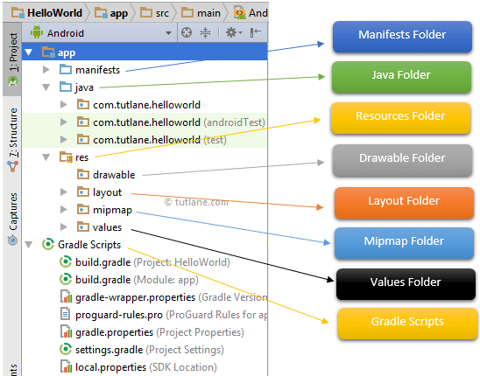
Once we setup android development environment using android studio and if we create a sample application using android studio, our project folder structure will be like as shown below. In case if you are not aware of creating an application using an android studio please check this Android Hello World App.
The Android project structure on the disk might be differs from the above representation. To see the actual file structure of the project, select Project from the Project dropdown instead of Android.
The android app project will contain different types of app modules, source code files, and resource files. We will explore all the folders and files in the android app.
Java Folder
This folder will contain all the java source code (.java) files which we’ll create during the application development, including JUnit test code. Whenever we create any new

Slide 3
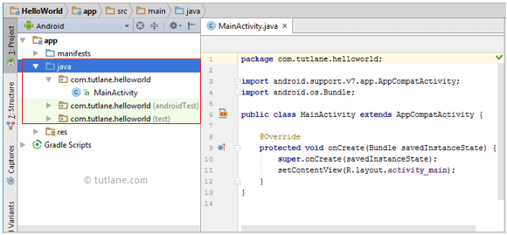
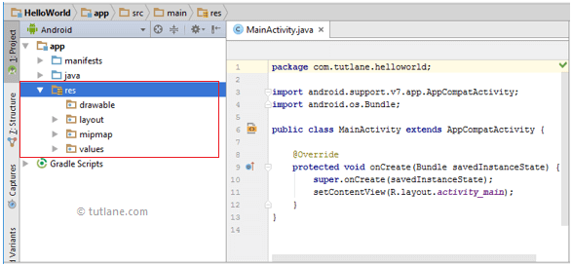
project/application, by default the class file MainActivity.java will create automatically under the package name “com.tutlane.helloworld” like as shown below.
res (Resources) Folder
It’s an important folder that will contain all non-code resources, such as bitmap images, UI strings, XML layouts like as shown below.
The res (Resources) will contain a different type of folders that are

Slide 4
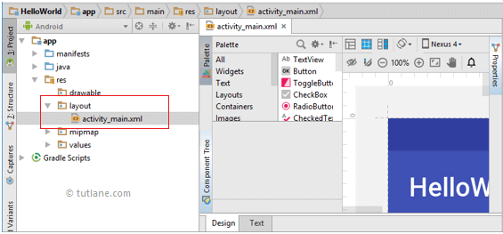
Drawable Folder (res/drawable)
It will contain the different types of images as per the requirement of application. It’s a best practice to add all the images in a drawable folder other than app/launcher icons for the application development.
Layout Folder (res/layout)
This folder will contain all XML layout files which we used to define the user interface of our application. Following is the structure of the layout folder in the android application.
Mipmap Folder (res/mipmap)
This folder will contain app / launcher icons that are used to show on the home screen. It will contain different density type of icons such as hdpi, mdpi, xhdpi, xxhdpi, xxxhdpi, to use different icons based on the size of the device.
Following is the structure of the mipmap folder in the android application.

Slide 5
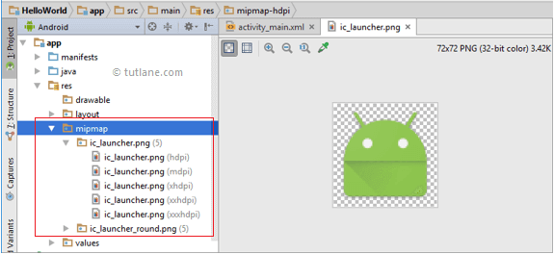
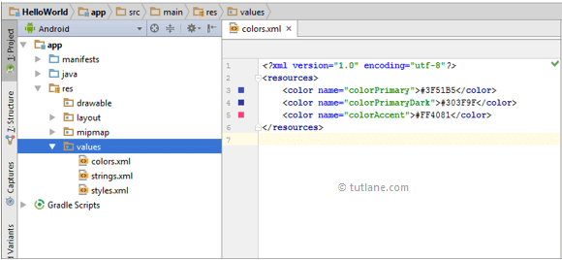
Values Folder (res/values)
This folder will contain various XML files, such as strings, colors, style definitions and a static array of strings or integers. Following is the structure of the values folder in android application.
Manifests Folder
This folder will contain a manifest file (AndroidManifest.xml) for our android application. This manifest file will contain information about our application such as android version, access permissions, metadata, etc. of our application and its components. The manifest file will act as an intermediate between android OS and our application.

Slide 6
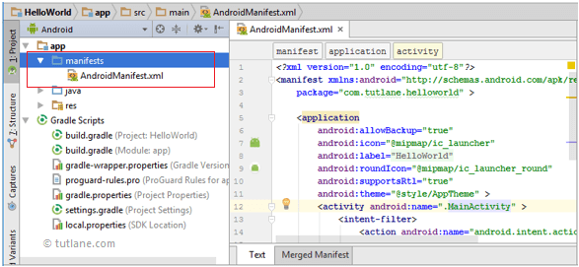
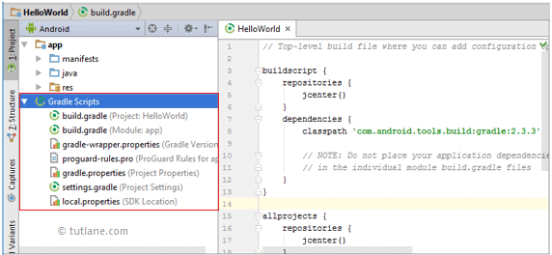
Following is the structure of the manifests folder in the android application.
Gradle Scripts
In android, Gradle means automated build system and by using this we can define a build configuration that applies to all modules in our application. In Gradle build.gradle (Project), and build.gradle (Module) files are useful to build configurations that apply to all our app modules or specific to one app module.
Following is the structure of Gradle Scripts in the android application.
Following are the important files which we need to implement an app in android studio.
Android Layout File (activity_main.xml)

Slide 7
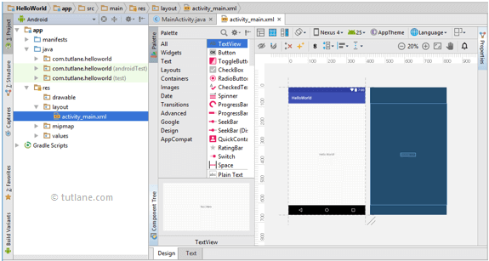
The UI of our application will be designed in this file contain Design and Text modes. It will exists in the layouts folder and of activity_main.xml file in Design mode like as shown below.
and it will the structure
We can make required design modifications in activity_main.xml file either using Design or Text modes. If we switch to Text mode activity_main.xml file will contain a code like as shown below.
<?xml version="1.0" encoding="utf-8"?>
<android.support.constraint.ConstraintLayout xmlns:android="http://schemas.android.com/ap k/res/android"
xmlns:app="http://schemas.android.com/apk/res-auto"
xmlns:tools="http://schemas.android.com/tools" android:layout_width="match_parent" android:layout_height="match_parent" tools:context="com.tutlane.helloworld.MainActivity">
<TextView android:layout_width="wrap_content" android:layout_height="wrap_content" android:text="Hello World!"
app:layout_constraintBottom_toBottomOf="parent"

Slide 8
app:layout_constraintLeft_toLeftOf="parent" app:layout_constraintRight_toRightOf="parent" app:layout_constraintTop_toTopOf="parent" />
</android.support.constraint.ConstraintLayout>
Android Main Activity File (MainActivity.java)
The main activity file in the android application is MainActivity.java and it will exist in the java folder. The MainActivity.java file will contain the java code to handle all the activities related to our app.
Following is the default our HelloWorld application.
code of MainActivity.java file
which
is generated by
package com.tutlane.helloworld;
import android.support.v7.app.AppCompatActivity; import android.os.Bundle;
public class MainActivity extends AppCompatActivity {
@Override
protected void onCreate(Bundle savedInstanceState) { super.onCreate(savedInstanceState); setContentView(R.layout.activity_main);
}
}
Android Manifest File (AndroidManifest.xml)
Generally, our application will contain multiple activities and we need to define all
those activities in the AndroidManifest.xml file. In our manifest file, we need to mention the main activity for our app using the MAIN action and LAUNCHER category attributes
in intent filters (<intent-filter>). In case if we didn’t mention MAIN action or LAUNCHER
category for the main activity, our app icon will not appear in the home screen’s list of apps.
Following is the default code of AndroidManifest.xml file which is generated by our HelloWorld application.

Slide 9
<?xml version="1.0" encoding="utf-8"?>
<manifest xmlns:android="http://schemas.android.com/apk/res/android" package="com.tutlane.helloworld" >
<application android:allowBackup="true" android:icon="@mipmap/ic_launcher" android:label="@string/app_name"
android:roundIcon="@mipmap/ic_launcher_round"
android:supportsRtl="true" android:theme="@style/AppTheme" >
<activity android:name=".MainActivity" >
<intent-filter>
<action android:name="android.intent.action.MAIN" />
<category android:name="android.intent.category.LAUNCHER" />
</intent-filter>
</activity>
</application>
</manifest>
These are the main folders and files required to implement an application in android studio. If you want to see the actual file structure of the project, select Project from the Project dropdown instead of Android.

Slide 10
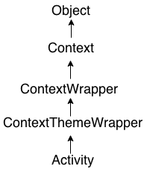
Android Activity Lifecycle
Android Activity Lifecycle is controlled by 7 methods of android.app.Activity class. The android Activity is the subclass of ContextThemeWrapper class.
An activity is the single screen in android. It is like window or frame of Java.
By the help of activity, you can place all your UI components or widgets in a single screen.
The 7 lifecycle method of Activity describes how activity will behave at different states.
Android Activity Lifecycle methods
Let's see the 7 lifecycle methods of android activity.
Method Description
onCreate | called when activity is first created.
onStart | called when activity is becoming visible to the user.
onResume | called when activity will start interacting with the user.

Slide 11
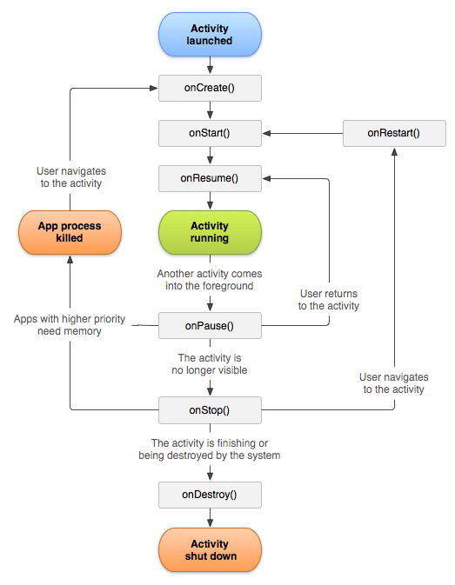
onPause | called when activity is not visible to the user.
onStop | called when activity is no longer visible to the user.
onRestart | called after your activity is stopped, prior to start.
onDestroy | called before the activity is destroyed.

Slide 12
File: activity_main.xml
<?xml version="1.0" encoding="utf-8"?>
<android.support.constraint.ConstraintLayout xmlns:android="http://schemas.android.co m/apk/res/android"
xmlns:app="http://schemas.android.com/apk/res-auto"
xmlns:tools="http://schemas.android.com/tools" android:layout_width="match_parent"
android:layout_height="match_parent" tools:context="example.javatpoint.com.activitylifecycle.MainActivity">
3.
4.
5.
6.
7.
8.
9.
10.
11.
12.
13.
14.
15.
16.
17.
<TextView android:layout_width="wrap_content" android:layout_height="wrap_content" android:text="Hello World!"
app:layout_constraintBottom_toBottomOf="parent"
app:layout_constraintLeft_toLeftOf="parent" app:layout_constraintRight_toRightOf="parent" app:layout_constraintTop_toTopOf="parent" />
18. </android.support.constraint.ConstraintLayout>
Android Activity Lifecycle Example
It provides the details about the invocation of life cycle methods of activity. In this example, we are displaying the content on the logcat.
File: MainActivity.java
1. package example.javatpoint.com.activitylifecycle; 2.
3.
4.
5.
6.
7.
8.
9.
10.
import android.app.Activity; import android.os.Bundle; import android.util.Log;
public class MainActivity extends Activity {
@Override
protected void onCreate(Bundle savedInstanceState) {

Slide 13
11.
12.
13.
14. }
@Override
protected void onStart() {
super.onStart();
Log.d("lifecycle","onStart invoked");
19. }
@Override
protected void onResume() {
super.onResume();
Log.d("lifecycle","onResume invoked");
24. }
@Override
protected void onPause() {
super.onPause();
Log.d("lifecycle","onPause invoked");
29. }
@Override
protected void onStop() {
super.onStop();
Log.d("lifecycle","onStop invoked");
34. }
@Override
protected void onRestart() {
super.onRestart();
Log.d("lifecycle","onRestart invoked");
39. }
@Override
protected void onDestroy() {
super.onDestroy();
Log.d("lifecycle","onDestroy invoked");
44. }
45. }
super.onCreate(savedInstanceState); setContentView(R.layout.activity_main); Log.d("lifecycle","onCreate invoked");

Slide 14
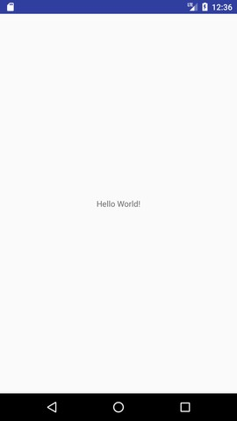
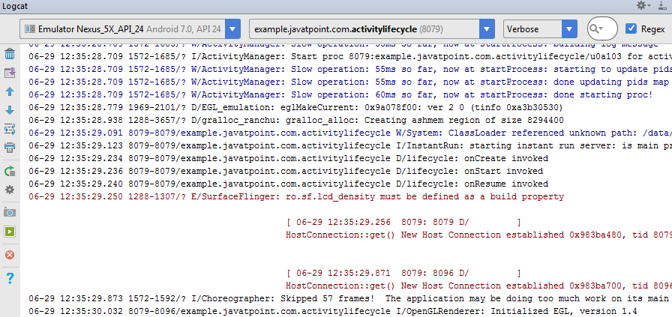
Output:
You will not see any output on the emulator or device. You need to open logcat.
Now see on the logcat: onCreate, onStart and onResume methods are invoked.
Now click on the HOME Button. You will see onPause method is invoked.

Slide 15
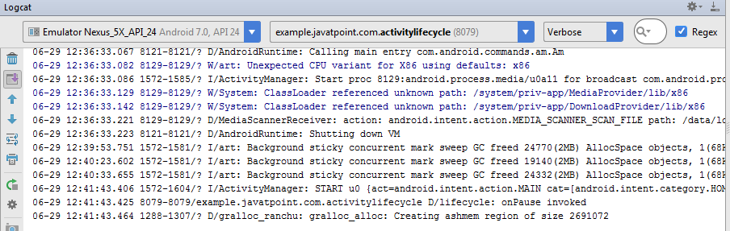
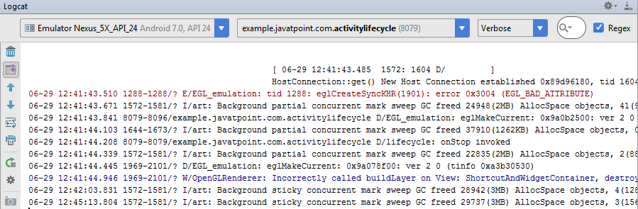
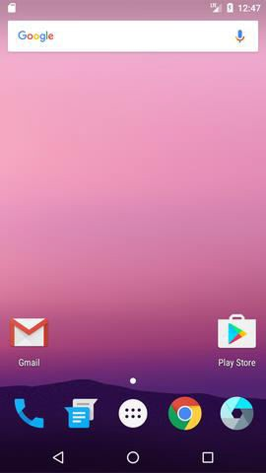
After a while, you will see onStop method is invoked.
Now see on the emulator. It is on the home. Now click on the center button to
launch the app again.
Now click on the lifecycleactivity icon.

Slide 16
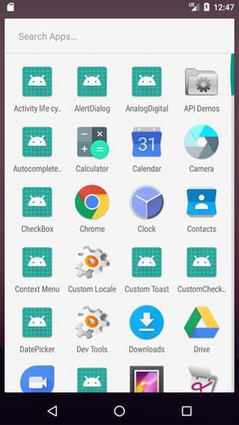
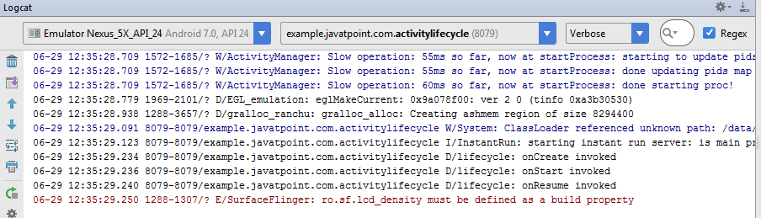
Now see on the logcat: onRestart, onStart and onResume methods are invoked.
If you see the emulator, application is started again.

Slide 17
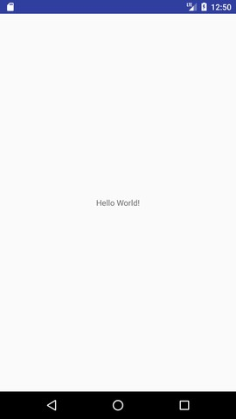
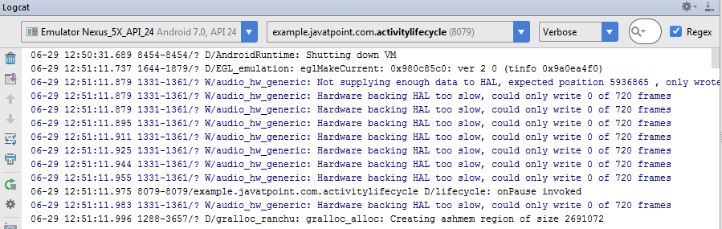
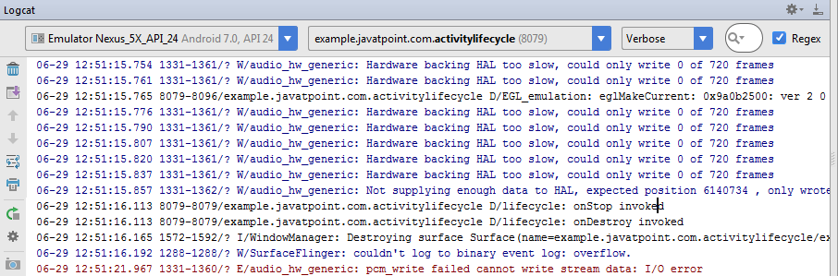
Now click on the back button. Now you will see onPause methods is invoked.
After a while, you will see onStop and onDestroy methods are invoked.

Slide 18
Fragment and Fragment Life Cycle
Android Fragment is the part of activity, it is also known as sub-activity. There can be more than one fragment in an activity. Fragments represent multiple screen inside one activity.
Android fragment lifecycle is affected by activity lifecycle because fragments are included in activity.
Each fragment has its own life cycle methods that is affected by activity life cycle because fragments are embedded in activity.
The FragmentManager class is responsible to make interaction between fragment objects.
Android Fragment Lifecycle

Slide 19
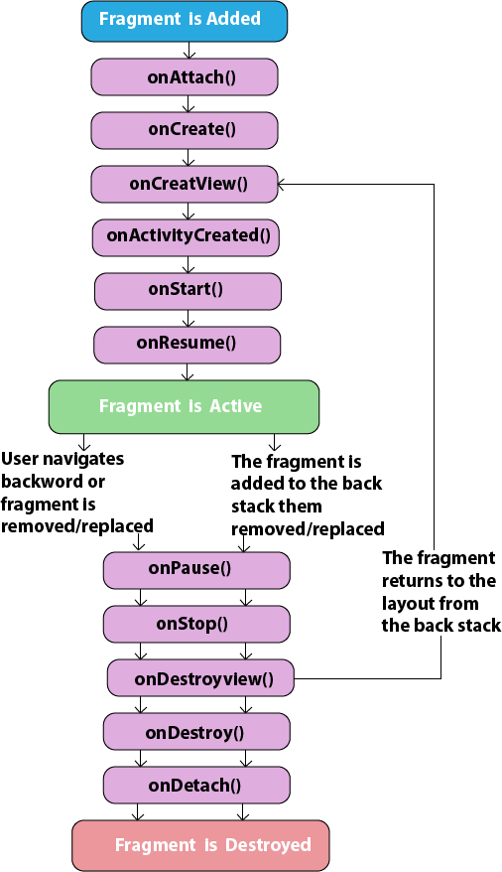
The lifecycle of android fragment is like the activity lifecycle. There are 12 lifecycle methods for fragment.

Slide 20
Android Fragment Lifecycle Methods
No. | Method | Description
1) | onAttach(Activity) | it is called only once when it is attached with activity.
2) | onCreate(Bundle) | It is used to initialize the fragment.
3) | onCreateView(LayoutInflater, ViewGroup, Bundle) | creates and returns view hierarchy.
4) | onActivityCreated(Bundle) | It is invoked after the completion of onCreate() method.
5) | onViewStateRestored(Bundle) | It provides information to the fragment that all the saved state of fragment view hierarchy has been restored.
6) | onStart() | makes the fragment visible.
7) | onResume() | makes the fragment interactive.
8) | onPause() | is called when fragment is no longer interactive.
9) | onStop() | is called when fragment is no longer visible.
10) | onDestroyView() | allows the fragment to clean up resources.
11) | onDestroy() | allows the fragment to do final clean up of fragment state.
12) | onDetach() | It is called immediately prior to the fragment no longer being associated with its activity.

Slide 21
Android Fragment Example
Let's have a look at the simple example of android fragment.
activity_main.xml
File: activity_main.xml
<?xml version="1.0" encoding="utf-8"?>
<LinearLayout xmlns:android="http://schemas.android.com/apk/res/android"
xmlns:app="http://schemas.android.com/apk/res-auto"
xmlns:tools="http://schemas.android.com/tools"
android:layout_width="fill_parent"
android:layout_height="fill_parent"
tools:context="example.javatpoint.com.fragmentexample.MainActivity"> 8.
9.
10.
11.
12.
13.
14.
15.
16.
17.
18.
19.
20.
21.
22.
23.
24.
<fragment
android:id="@+id/fragment1" android:name="example.javatpoint.com.fragmentexample.Fragment1"
android:layout_width="0px" android:layout_height="match_parent" android:layout_weight="1"
/>
<fragment
android:id="@+id/fragment2" android:name="example.javatpoint.com.fragmentexample.Fragment2"
android:layout_width="0px" android:layout_height="match_parent" android:layout_weight="1"
/>
25. </LinearLayout>

Slide 22
File: fragment_fragment1.xml
<FrameLayout xmlns:android="http://schemas.android.com/apk/res/android"
xmlns:tools="http://schemas.android.com/tools"
android:layout_width="match_parent"
android:layout_height="match_parent"
android:background="#F5F5DC"
tools:context="example.javatpoint.com.fragmentexample.Fragment1"> 7.
8.
9.
10.
11.
12.
13.
<!-- TODO: Update blank fragment layout -->
<TextView android:layout_width="match_parent" android:layout_height="match_parent"
android:text="@string/hello_blank_fragment" />
14. </FrameLayout>
File: fragment_fragment2.xml
<FrameLayout xmlns:android="http://schemas.android.com/apk/res/android"
xmlns:tools="http://schemas.android.com/tools"
android:layout_width="match_parent"
android:layout_height="match_parent"
android:background="#F0FFFF"
tools:context="example.javatpoint.com.fragmentexample.Fragment2"> 7.
8.
9.
10.
11.
12.
13.
<!-- TODO: Update blank fragment layout -->
<TextView
android:layout_width="match_parent"
android:layout_height="match_parent" android:text="@string/hello_blank_fragment" />
14. </FrameLayout>

Slide 23
MainActivity class
File: MainActivity.java
1. package example.javatpoint.com.fragmentexample; 2.
3.
4.
5.
6.
7.
8.
9.
10.
11.
12.
import android.support.v7.app.AppCompatActivity;
import android.os.Bundle;
public class MainActivity extends AppCompatActivity {
@Override
protected void onCreate(Bundle savedInstanceState) {
super.onCreate(savedInstanceState); setContentView(R.layout.activity_main);
}
13. }
File: Fragment1.java
package example.javatpoint.com.fragmentexample;
import android.os.Bundle;
import android.support.v4.app.Fragment;
import android.view.LayoutInflater;
import android.view.View;
import android.view.ViewGroup; 6.
7.
8.
9.
10.
11.
12.
13.
14.
15.
16.
public class Fragment1 extends Fragment {
@Override
public void onCreate(Bundle savedInstanceState) {
super.onCreate(savedInstanceState);
}
@Override
public View onCreateView(LayoutInflater inflater, ViewGroup container, Bundle savedInstanceState) {

Slide 24
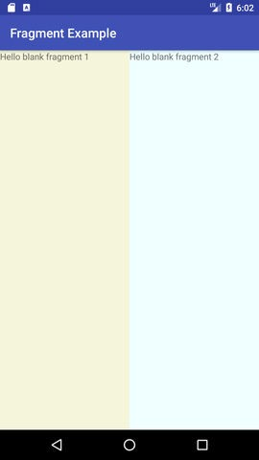
17.
18.
19. }
20. }
// Inflate the layout for this fragment
return inflater.inflate(R.layout.fragment_fragment1, container, false);
File: Fragment2.java
1. package example.javatpoint.com.fragmentexample; 2.
3.
4.
5.
6.
7.
8.
9.
10.
11.
12.
13.
14.
15.
16.
17.
18.
19.
20.
21.
22.
import android.os.Bundle;
import android.support.v4.app.Fragment; import android.view.LayoutInflater; import android.view.View;
import android.view.ViewGroup;
public class Fragment2 extends Fragment {
@Override
public void onCreate(Bundle savedInstanceState) {
super.onCreate(savedInstanceState);
}
@Override
public View onCreateView(LayoutInflater inflater, ViewGroup container, Bundle savedInstanceState) {
// Inflate the layout for this fragment
return inflater.inflate(R.layout.fragment_fragment2, container, false);
}
23. }

Slide 25
Introduction to Android Views and ViewGroups
Views
View is the basic building block of UI(User Interface) in android. View refers to the android.view.View class, which is the super class for all the GUI components like TextView, ImageView, Button etc.
View class extends Object class and implements Drawable.Callback, KeyEvent.Callback and AccessibilityEventSou rce.
View can be considered as a rectangle on the screen that shows some type of content. It can be an image, a piece of text, a button or anything that an android application can display. The rectangle here is actually invisible, but every view occupies a rectangle shape.
The question that might be bothering you would be , what can be the size of this rectangle?
The answer is either we can set it manually, by specifying the exact size(with proper units) or by using some predefined values. These predefined values are match_parent and wrap_content.
match_parent means it will occupy the complete space available on the display of the device. Whereas, wrap_content means it will occupy only that much space as required for its content to display.

Slide 26
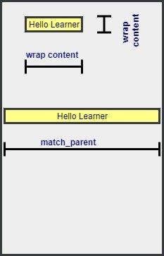
A View is also known as Widget in Android. Any visual(that we can see on screen) and interactive(with which user can interact with) is called a Widget.
XML syntax for creating a View
Now, as we have explained earlier as well, to draw anything in your android application, you will have to sepcify it in the design XML files. And to add functionality we will create Java files.
Every view in XML has the following format:
<ViewName
Attribute1=Value1 Attribute2=Value2

Slide 27
Attribute3=Value3
.
.
AttributeN=ValueN
/>
It always start with an angle bracket, followed by the View name. We will introduce you to various types of Views very soon.
Then we write attributes that will define how that view will look on the screen of the application along with a value for the attribute. Each view has its own attributes which we will discuss in the next few tutorials which will cover various typs of views.
In the end, it is closed by />
So, every View subclass needs to follow this format so that it can appear on the screen of the app. And this format is nothing but default XML style. Right!
There are two attributes that are necessary for every View. These are: android:layout_height and android:layout_width.
These attributes define the size of the invisible rectangle that a view makes. Using these attributes we can easily control the size for every view in our android application.
Apart from the above mentioned attributes, attributes like gravity, layout_gravity, padding and margin are some other commonly used attributes.

Slide 28
Most commonly used Android View classes
Here we have some of the most commonly used android View classes:
TextView
EditText
Button
ImageView
ImageButton
CheckBox
RadioButton
ListView
GridView
DatePicker
Spinner, etc.

Slide 29
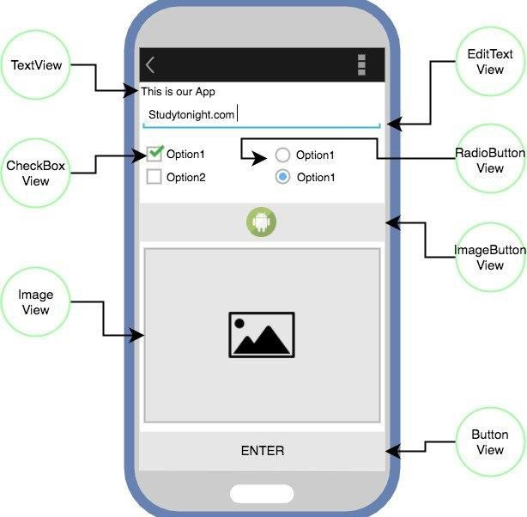
Programmatic and Declarative Approach
To create/define a View or a ViewGroup in your android application, there are two possible ways:
1. The Programmatic Approach: In this we define/create our Views in the Java source file. We will learn about this approach in details later, as of now here is a sample code to add a Button to our view.

Slide 30
Button myButton = new Button(this);
myButton.setLayoutParams(new LinearLayout.LayoutParams( 4.
LinearLayout.LayoutParams.MATCH_PARENT,
5.
LinearLayout.LayoutParams.MATCH_PARENT));
6.
myLayout.addView(myButton);
Copy
So addView() is the function used to add any View to the UI and setLayoutParams() function is used to set the various attributes.
7. The Declarative Approach: In this we define the View and ViewGroups directly in the design XML files, like we will be doing in the next couple of tutorials where we will study about various commonly used views.

Slide 31
TextView in Android
TextView is the most widely used view used to show pre-defined text on
display screen.
This is a view which is not only used alone, but is also used along with other Views as well, like when you are creating a form, where you have EditText view, CheckBox view etc, then to mention the labels and other
information, we will have to use the TextView alongside.
Following are some of the main attributes that are most commonly used:
Attribute | Description
android:text | Used to specify the text to be displayed in the TextView
android:textSize | Using this attribute we can control the size of the text.
android:textColor | Using this attribute we can specify the color of our text.
android:textAllCaps | If set True, this will make the text appear in upper case.
android:letterSpacing | Using this attribute we can set the spacing between letters of the text.
android:hint | This attribute is used to show a default text, if no text is

Slide 32
set in the TextView. Generally, when we populate a TextView using dynamic data coming from server(using the programmatic approach), then we set this attribute to show some default text in the TextView until data is fetched from server.
How To Define A Textview In The Design Layout XML:
<TextView
android:id="@+id/st" android:layout_width="wrap_content" android:layout_height="wrap_content"
android:text="Studytonight" android:textSize="45sp"
android:padding="20dp" android:textColor="#DD2C00"/>
First we open the tag with < and type TextView, indicating we are creating a TextView that will get displayed in the app. Now lets see what the attributes mentioned above do.
As mentioned
earlier, android:layout_width="wrap_content" and android:layou t_height="wrap_content" are compulsory to write for every view,

Slide 33
because we must define the width and height for every view that we create.
android:id="@+id/tv_text_gender"
This gives an id(identification) to this textview which can be used in Java files to access this textview and to make any changes to it dynamically. For example, suppose we set some initial text as "study". But we want the text to be
as "studytonight" after we touch the screen. So, we use this id in our Java class and use some predefined function to
change the text of the TextView during runtime, when the user taps on it. We will learn how to do so very soon.
android:text="StudyTonight"
The TextView will show the given value in the attribute as the text.
android:textSize="45sp"
This is used to determine the size of the text displayed in the TextView.
android:padding="20dp"
This provides a padding of 20dp arround the text. More on padding here in this tutorial.
android:textColor="#DD2C00"
This sets the color of the text. #DD2C00 is the hexa code for color some dark red shade. You can easily look for Hexa codes for various colors from ColorHexa or from the official material design website - Material Colors
Also, there are some predefined colors in Android Studio that are stored under color.xml file in the values directory. To access this, you can use "@android:color/your_color_name" as the value in the above attribute.

Slide 34
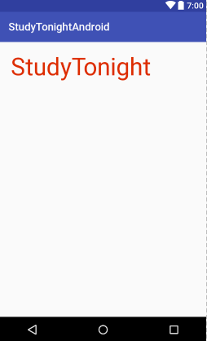
You can also define the colors which you use oftenly in your app in the color.xml styles file. It is a very good practice to do so, because if you decide to change the color code/shade, all you have to do is change it in the color.xml file and it will get changed everywhere.
Output Screen

Slide 35
EditText View in Android
EditText is a TextView which is editable. It has almost similar properties
as a TextView. EditText is used when you want to have a text field in your application where user can enter any text. It can be either single line or multi-line. Touching a text field places makes the field active, places a cursor and automatically displays the keyboard.
Attribute | Description
android:inputType | Used to specify what the text entered should be like and for what purpose it will be used. If this is set to none, then the text cannot be edited. Some commonly used constant values for this attribute are: text textAutoComplete - This provides with suggestions as user is typing in text. textAutoCorrect - This will enable auto correct on user input text. textPassword - Display the entered text in form of dots or stars. textUri textEmailAddress phone - This will present only the numeric keyboard to users. datetime, etc.

Slide 36
 | All the available constant values can be checked here. We can use more than one constant value, by separating them using |, for example :
 | android:inputType="textCapSentences|textAut oCorrect"
 | Copy
android:imeOptions | In most input methods, like keyboard or SMS sending form, the bottom right corner of the keyboard has an action button appropriate for that input method. It can be Done, Next, Send, Go etc. To specify the keyboard action button, use the android:imeOptions attribute with an action value such as actionSend or actionSearch etc.
android:minLines | It provides the view, with a height equivalent to the specified number of lines on the screen. So, if you enter a value 2, then by default the EditText view will be 2 lines tall, even without any text added to it. It will the the default height.
android:maxLines | It sets the maximum number of lines that the EditText view can accomodate, visually. In other words when we say maxLines has a value 3, it means that the EditText view field will be 3 lines tall after which it will stop increasing in size as more and more text is added to it, usually a scroll bar is shown when number of lines exceeds the limit set.
android:hint | It displays a hint message before anyone types in the EditText.
android:maxLength | It allows to specify the maximum number of characters that the user can enter into the field.

Slide 37
Below is a sample of a default EditText field:
<EditText
android:id="@+id/et_address" android:layout_width="match_parent" android:layout_height="wrap_content"
android:hint="Write your email Address here" android:textSize="20sp"
android:inputType="textWebEmailAddress" android:imeOptions="actionDone"
android:maxLines="3"/>

Slide 38
Button View in Android
Button, as understood by its name, is a component which can be pressed or clicked by the user to perform an action. It has the same properties as a TextView, with a few Button specific properties.
Below we have specified how to define a button view in your android application using the layout XML:
<Button
android:id="@+id/btn_submit" android:layout_width="match_parent" android:layout_height="wrap_content" android:text="Submit"
android:textColor="@android:color/holo_blue_dark"
/>
Copy
The main usage of the Button view is that whenever we click a button, we can set a method that will handle that specific button request and will carry out the necessary action. This can be done inside the Activity class as following:
public class MainActivity extends Activity {
@Override
protected void onCreate(Bundle savedInstanceState) {
super.onCreate(savedInstanceState);

Slide 39
setContentView(R.layout.activity_main);
// creating instance of button Button b = (Button)
findViewById(R.id.btn_submit);
// setting on click event listener b.setOnClickListener(new
View.OnClickListener() {
public void onClick(View v) {
// Perform action on click
}
});
}
}
Therefore, whenever we press the button with id btn_submit, the above method is called which executes the code inside it.

Slide 40
Using android:onClick to add behaviour to Button
We can also assign a method directly in the layout XML while defining the button using, android:onClick attribute, like specified below.
<Button
android:id="@+id/btn_submit"
android:layout_width="match_parent" android:layout_height="wrap_content" android:text="Submit"
android:textColor="@android:color/holo_blue_dark" android:onClick="study"
/>
When user will click on the Button defined in the above layout xml file, then Android system will call study(View) method, defined in MainActivity.java file. In order for this to work, the method must be public and accept a View type as its only parameter.
public void study(View view) {
//Perform action on click
}

Slide 41
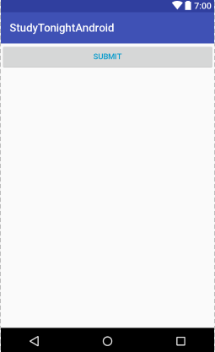
Output Screen
Commonly used attributes for Button
Here are some commonly used attributes for styling the Button View
android:gravity: This can be used to set the position of any View on the app screen. The available value
are right, left, center, center_vertical etc. You can also use to values together, using the | symbol.
android:textSize: To set text size inside button.
android:background: To set the background color of the button.
Picture can be added to the button, alongside the text by
using android:drawableRight, android:drawableLeft, android:drawableTop an d android:drawableBottom, respectively.:

Slide 42
•
ImageView and ImageButton in Android
ImageView in Android
ImageView is used to show any picture on the user interface.
Following are some of the main attributes that are most commonly used:
Attribute | Description
android:maxHeight | Used to specify a maximum height for this view.
android:maxWidth | Used to specify a maximum width for this view.
android:src | Sets a drawable as the content for this ImageView.
android:scaleType | Controls how the image should be resized or moved to match the size of the ImageView.
android:tint | Tints the color of the image in the ImageView.
Therefore, any image that we want to display in the app should be placed under the drawable folder. This folder can be found under app → res →

Slide 43
drawable. To insert an image, simply copy the image and then right click on drawable → Paste.
Following is the code which we need to add into the layout XML file to add an ImageView to our app screen.
<ImageView
•
•
•
•
•
android:id="@+id/img" android:layout_width="match_parent" android:layout_height="wrap_content" android:scaleType="fitCenter" android:src="@drawable/img_nature"/>
•
A few more, commonly used attributes with ImageView Following are some of the commonly used attributes:
android:background: This property gives a background color to your ImageView. When your image is not able to entirely fill the ImageView, then background color is used to fill the area not covered by the image.
android:padding: To provide padding or extra space inside the ImageView for the image.
All scaleType in ImageView
Here we have specified all the possible values for the attribute scaleType which can be used in your app for ImageView:
CENTER: Places the image in center, but does not scale it.
CENTER_CROP: Scales the image uniformly.

Slide 44
CENTER_INSIDE: This will place the image inside the container and the edges of the image will not overlap with that of the container, the image will be inside it.
FIT_CENTER: Scale the image from the center.
FIT_END: Scale the image from the end of the container, i.e from the right hand side.
FIT_START: Scale the image from the start of the container, i.e from the left hand side.
FIT_XY: This will fill the complete container with the image. This generally distorts the image by stretching/sqeezing it in disproportionate ratios.
MATRIX: Used to scale the image using the image matrix when drawing.

Slide 45
Using an Image as Button
ImageButton has the same property as ImageView. Only one feature is extra, which is, images set through ImageButton are clickable, and actions can be attached with them upon clicking.
Here is how you define an ImageButton in the layout XML file:
<ImageButton
android:id="@+id/imgButton" android:layout_width="match_parent" android:layout_height="wrap_content" android:scaleType="fitCenter" android:src="@drawable/img_nature"/>
Just like a button, the setOnClickListener() can be used to set an event listener for click event on this.
imageButton = (ImageButton)findViewById(R.id.imgButton);
imageButton.setOnClickListener(new View.OnClickListener() {
@Override
public void onClick(View v) {
// do anything here

Slide 46
}
});

Slide 47
Using Radio Button and Check Box in Android
Let's start with RadioButton and RadioGroup
So let's begin. Create a new Android Application Project and copy the below content of the XML layout file.
<?xml version="1.0" encoding="utf-8"?>
<RelativeLayout xmlns:android="http://schemas.android.com/apk/res/android"
xmlns:tools="http://schemas.android.com/tools" android:layout_width="match_parent" android:layout_height="match_parent" tools:context="com.example.studytonightandroid.MainActivity" >
<TextView android:id="@+id/tvRg"
android:layout_width="match_parent" android:layout_height="wrap_content"
android:layout_alignParentTop="true" android:layout_centerHorizontal="true" android:gravity="center" android:text="Rate This Lesson"

Slide 48
android:textAppearance="?android:attr/textAppearanceMedium" />
<RadioGroup
android:layout_width="match_parent" android:layout_height="wrap_content"
android:layout_below="@+id/tvRg" android:layout_centerHorizontal="true" android:orientation="horizontal" android:showDividers="beginning|middle|end" android:layout_marginTop="10dp" android:id="@+id/radioGroup" >
<RadioButton
android:id="@+id/rb1"
android:layout_width="wrap_content" android:layout_height="wrap_content" android:text="EXCELLENT" android:checked="false" />

Slide 49
<RadioButton
android:id="@+id/rb2" android:layout_width="wrap_content" android:layout_height="wrap_content" android:text="GOOD" android:checked="true" />
<RadioButton
android:id="@+id/rb3" android:layout_width="wrap_content" android:layout_height="wrap_content" android:text="OKAY" android:checked="false" />
<RadioButton
android:id="@+id/rb4" android:layout_width="wrap_content" android:layout_height="wrap_content"

Slide 50
android:text="POOR" android:checked="false" />
</RadioGroup>
<Button
android:layout_width="wrap_content" android:layout_height="wrap_content" android:text="SUBMIT" android:id="@+id/btnSubmit" android:layout_below="@+id/radioGroup" android:layout_centerHorizontal="true" android:layout_marginTop="10dp"/>
</RelativeLayout>
Copy
You will see the following output:

Slide 51
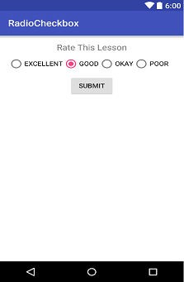
Once the layout is done, we will now work on the background logic(backend) of the user interface which will fetch the user selection and display it on the screen using a toast.
So we will require the views that the user will interact with so that we can get the necessary information. Then we need to implement click
listener on the Submit button.
Inside the onClickListener() first we have to get the selected radio button id from the RadioGroup. Once we have the id of the selected Radio Button, we can easily fetch the text value of the selected radio button to display it on screen. Let's implement this. Below we have the MainActivity.java file with all the code.
package com.example.akshay.studytonightandroid;
import android.os.Bundle;
import android.support.v7.app.AppCompatActivity; import android.view.View;

Slide 52
import android.widget.Button;
import android.widget.RadioButton; import android.widget.RadioGroup; import android.widget.Toast;
public class MainActivity extends AppCompatActivity {
// These are the global variables
RadioGroup radioGroup; RadioButton selectedRadioButton;
Button buttonSubmit;
@Override
protected void onCreate(Bundle savedInstanceState) { super.onCreate(savedInstanceState);
setContentView(R.layout.activity_main);
// layout instances
buttonSubmit = (Button) findViewById(R.id.buttonSubmit);

Slide 53
radioGroup = (RadioGroup) findViewById(R.id.radioGroup);
/*
Submit Button
*/
buttonSubmit.setOnClickListener(new View.OnClickListener() {
@Override
public void onClick(View v) {
// get the selected RadioButton of the group selectedRadioButton =
(RadioButton)findViewById(radioGroup.getCheckedRadioButtonId());
//get RadioButton text
String yourVote = selectedRadioButton.getText().toString();
// display it as Toast to the user Toast.makeText(MainActivity.this, "Selected Radio Button is:"
+ yourVote , Toast.LENGTH_LONG).show();
}
});
}

Slide 54
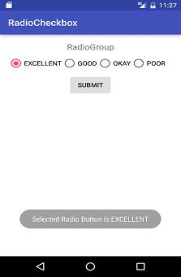
}
Copy
To get the selected radio button, we have
used radioGroup.getCheckedRadioButtonId() method, which returns the id of the selected radio button.
Then to get the text of the selected radio button, we have
used getText() method on that selected radio button. The text we receive from this method is converted to String type using the toString() method. Finally, we have displayed the selected option value to the user using a Toast.
Add the above code in the MainActivity.java file and then run your Android Application Project. The result will be similar to the image shown below. Whenever the user selects any option, it will be displayed to the user as a Toast.

Slide 55
It's Time for CheckBox
Now, it's time to play with some check boxes. Extend the UI design by copy-pasting the following code after the Button view
(with id as btnSubmit) in the layout XML file.
<TextView android:id="@+id/tvCb"
android:layout_width="match_parent" android:layout_height="wrap_content" android:layout_below="@+id/radioGroup" android:gravity="center" android:text="Give Your Suggestions Here." android:layout_marginTop="65dp"
android:textAppearance="?android:attr/textAppearanceMedium"/>
<CheckBox android:layout_width="match_parent" android:layout_height="wrap_content" android:text=" I really enjoy this lesson." android:id="@+id/cb1" android:layout_below="@+id/tvCb" android:layout_centerHorizontal="true"

Slide 56
android:checked="false"/>
<CheckBox
android:layout_width="match_parent" android:layout_height="wrap_content"
android:text="I will prefer this lesson over any other." android:id="@+id/cb2" android:layout_below="@+id/cb1" android:layout_centerHorizontal="true" android:checked="false"/>
<CheckBox
android:layout_width="match_parent" android:layout_height="wrap_content" android:text="I would like to hear more from you."
android:id="@+id/cb3" android:layout_below="@+id/cb2" android:layout_centerHorizontal="true" android:checked="false"/>

Slide 57
<CheckBox android:layout_width="match_parent" android:layout_height="wrap_content"
android:text="I am satisfied with the content and full description." android:id="@+id/cb4"
android:layout_below="@+id/cb3" android:layout_centerHo

Slide 58
ListView in Android
ListView is used when you have to show items in a vertically scrolling list. Best example of it is our device's Contact List. With ListView, user can easily browse the information, while scrolling up and down. You can set divider between every item and set its height and color as per your UI design.
Inside a ListView, we can show list of Text items by using TextView, or pictures using ImageView, or any other view or a combination of views.
As ListView is generally used to display a large set of data, hence it is not feasible to manually create list items for the complete data, hence Android provides us with special Adapter classes which can be used to supply data from datasets to ListView.
Following are some of the main attributes that are most commonly used:
Attribute | Description
android:divider | Using this attribute we can specify a divider between List items. A drawable or any color can be specified as a value for this attribute.
android:dividerHeight | Used to specify height of the divider.

Slide 59
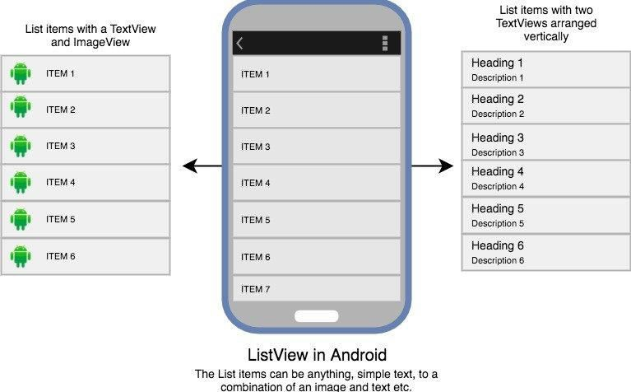
<ListView
android:id="@+id/listView" android:layout_width="match_parent" android:layout_height="match_parent" android:divider="@android:color/black" android:dividerHeight="1dp"/>

Slide 60
Using Adapter with ListView
ListView in the main layout XML file activity_main.xml.
<?xml version="1.0" encoding="utf-8"?>
<android.support.constraint.ConstraintLayout xmlns:android="http://schemas.android.com/apk/res/ android" xmlns:app="http://schemas.android.com/apk/res- auto" xmlns:tools="http://schemas.android.com/tools"
android:layout_width="match_parent" android:layout_height="match_parent" android:background="#FFEB3B"
tools:context="com.example.android.studytonightand roid.MainActivity">
<ListView
android:id="@+id/listView" android:layout_width="match_parent"
android:layout_height="match_parent" android:divider="@android:color/black" android:dividerHeight="1dp"/>

Slide 61
</android.support.constraint.ConstraintLayout>
Here we have a simple Array with festivals names in it:
String[] festivals = { "Diwali",
"Holi",
"Christmas", "Eid", "Baisakhi", "Halloween"
};
So now we will create a new XML file, with name list_item.xml in the layout folder, and add a TextView in it like this,
<?xml version="1.0" encoding="utf-8"?>
<TextView xmlns:android="http://schemas.android.com/apk/res/ android"
android:id="@+id/textView" android:layout_width="wrap_content" android:layout_height="wrap_content"

Slide 62
android:textStyle="bold"
android:layout_marginLeft="10dp" android:layout_marginTop="5dp" android:padding="4dp" android:textColor="#000000"
/>
package listview.studytonightexample.com.listview;
import
android.support.v7.app.AppCompatActivity;
import
android.os.Bundle;
import
android.view.View;
import
android.widget.AdapterView;
import
android.widget.ArrayAdapter;
import
android.widget.ListView;
import
android.widget.TextView;
import
android.widget.Toast;
public
class MainActivity extends
AppCompatActivity {
ListView listView;

Slide 63
TextView textView;
String[] festivals = { "Diwali",
"Holi", "Christmas", "Eid", "Baisakhi", "Halloween"
};
@Override
protected void onCreate(Bundle savedInstanceState) {
super.onCreate(savedInstanceState); setContentView(R.layout.activity_main);
listView = (ListView)findViewById(R.id.listView);
textView = (TextView)findViewById(R.id.textView);

Slide 64
final ArrayAdapter adapter = new ArrayAdapter(this,
R.layout.list_item, android.R.id.textView, festivals);
listView.setAdapter(adapter);
listView.setOnItemClickListener(new AdapterView.OnItemClickListener() {
@Override
public void adapterView, View view,
onItemClick(AdapterView<?> int position, long l) {
// TODO
Auto-generated method stub
/* appending Happy with
festival
name */
String value = "Happy " + adapter.getItem(position);
/* Display the Toast */
Toast.makeText(getApplicationContext(), Toast.LENGTH_SHORT).show();
value,
}
});

Slide 65
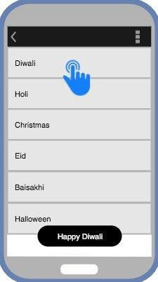
}
}
Copy
Output Screen

Slide 66
GridView in Android
GridView just works like ListView, about which we learned in details in the last tutorial. The only difference is that GridView is used to display grid of View objects.
Vertical and horizontal spacing between every single items of gridView can be set by verticalSpacing and horizontalSpacing.
ListView in the main layout XML file activity_main.xml.
<?xml version="1.0" encoding="utf-8"?>
<android.support.constraint.ConstraintLayout xmlns:android="http://schemas.android.com/apk/res/ android" xmlns:app="http://schemas.android.com/apk/res- auto" xmlns:tools="http://schemas.android.com/tools"
android:layout_width="match_parent" android:layout_height="match_parent" android:background="#FFEB3B"
tools:context="com.example.android.studytonightand roid.MainActivity">
<GridView
android:id="@+id/gridView" android:layout_width="match_parent"

Slide 67
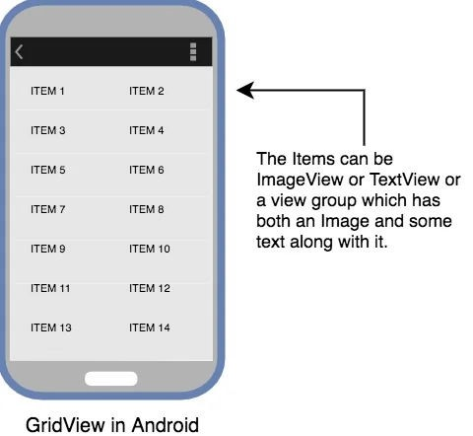
android:layout_height="match_parent"
android:verticalSpacing="10dp" android:horizontalSpacing="10dp" android:numColumns="2"/>
</android.support.constraint.ConstraintLayout>
Using Adapter with GridView
ListView in the main layout XML file activity_main.xml.

Slide 68
<?xml version="1.0" encoding="utf-8"?>
<android.support.constraint.ConstraintLayout xmlns:android="http://schemas.android.com/apk/res/ android" xmlns:app="http://schemas.android.com/apk/res- auto" xmlns:tools="http://schemas.android.com/tools"
android:layout_width="match_parent" android:layout_height="match_parent" android:background="#FFEB3B"
tools:context="com.example.android.studytonightand roid.MainActivity">
<GridView
android:id="@+id/gridView" android:layout_width="match_parent" android:layout_height="match_parent" android:verticalSpacing="10dp" android:horizontalSpacing="10dp" android:numColumns="2"/>
</android.support.constraint.ConstraintLayout>

Slide 69
So for this, let's take an array of some amazing car brands.
String[] carBrands = {
"Ferrari", "McLaren", "Jaguar",
"Skoda",
"Suzuki", "Hyundai", "Toyota", "Renault", "Mercedes", "BMW",
"Ford",
"Honda", "Chevrolet",
"Volkswagon",
};
Copy
As our Grid will have only text values, hence we must define a TextView.

Slide 70
So now we will create a new XML file, with name grid_item.xml in the layout folder, and add a TextView in it like this,
<?xml version="1.0" encoding="utf-8"?>
<TextView xmlns:android="http://schemas.android.com/apk/res/ android"
android:id="@+id/textView" android:layout_width="wrap_content"
android:layout_height="wrap_content" android:textStyle="bold" android:layout_marginLeft="10dp"
android:layout_marginTop="5dp"
android:padding="4dp" android:textColor="#000000"
/>
Copy
And the MainActivity.java file will look like this:
package listview.studytonightexample.com.listview;
import android.support.v7.app.AppCompatActivity;

Slide 71
import
android.os.Bundle;
import
android.view.View;
import
android.widget.AdapterView;
import
android.widget.ArrayAdapter;
import
android.widget.ListView;
import
android.widget.TextView;
import
android.widget.Toast;
public
class MainActivity extends
AppCompatActivity {
GridView gridView; TextView textView; String[] carBrands = {
"Ferrari", "McLaren", "Jaguar",
"Skoda",
"Suzuki", "Hyundai", "Toyota",

Slide 72
"Renault",
"Mercedes", "BMW",
"Ford",
"Honda",
"Chevrolet", "Volkswagon",
};
@Override
protected void onCreate(Bundle savedInstanceState) {
super.onCreate(savedInstanceState); setContentView(R.layout.activity_main);
gridView = (GridView)findViewById(R.id.gridView);
textView = (TextView)findViewById(R.id.textView);
final ArrayAdapter adapter = new ArrayAdapter(this,

Slide 73
android.R.layout.grid_item, android.R.id.textView, carBrands);
listView.setAdapter(adapter); listView.setOnItemClickListener(new
AdapterView.OnItemClickListener() {
@Override
public void onItemClick(AdapterView<?> adapterView, View view, int position, long l) {
// TODO Auto-generated method stub
/* appending I Love with car brand
names */
String value = "I Love " + adapter.getItem(position);
/* Display the Toast */
Toast.makeText(getApplicationContext(), value, Toast.LENGTH_SHORT).show();
}
});

Slide 74
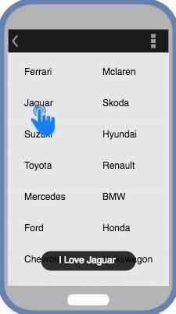

Slide 75
A Spinner is a type of view that hold items in form of a dropdown menu available for user selection. It creates a menu with multiple options where a user can select any one option. Following is an example of a spinner.
What's the difference between Spinner and ListView?
Both ListView and Spinner looks very similar. But they differ from each other.
Spinners provide a quick way to select one value from a given set of values and in the default state, a spinner only shows the currently selected value. When you touch(tap on) the spinner, it displays a dropdown menu with all other available values(options), from which the user can select a new one.
ListView, on the other hand, is a view group that displays a list of scrollable items. The list items are automatically inserted to the list using an Adapter that pulls content from a data source such as an array or database table and converts each dataitem into a view that is placed in the list.
Therefore, a Spinner and ListView differs in the way they appear and in their usage too. If you want to select only one value from a set of options then you should use a Spinner. If you want to display a list of data then use a list view.

Slide 76
How does a Spinner works?
1. Define the data source
There should be a data source that will be used to display the data in the spinner.
String days[] = {"Monday", "Tuesday", "Wednesday", "Thursday", "Friday", "Saturday", "Sunday"};
Copy
A data source can be a list, an array, a JSON data or data coming from a database.
2. Define the Adapter
There will be an Adapter(ArrayAdapter etc) to take data from data source, create a view of it and then pass it to the AdapterView i.e. Spinner. Thus, you need to tell the Adapter how to display the data by specifying a layout for the drop down.
ArrayAdapter<String> adapter = new ArrayAdapter<>(this, android.R.layout.simple_spinner_item, days);
Copy
There are 3 parameters used to instantiate an ArrayAdapter(we have used an ArrayAdapter in our example):
Context c: Refers to the current class object where ArrayAdapter is being instantiated.
Layout: It is a layout file that defines how a single item will appear in the spinner. Android SDK by default

Slide 77
provides layouts
like simple_spinner_item and simple_spinner_dropdown_item and if
you do not have any special design requirements, we suggest you use these only.
o Data source: It is the data source from which data will be converted into a view.
3. Define any actions for Spinner
To add an event handler for option selection, you can implement OnItemSelectedListener interface, to determine what happens when a user selects any option from the menu. For this, you need to implement the above mentioned interface and override two methods:
onItemSelected()
This method has 4 parameters:
AdapterView av: It's the Spinner view that you have used.
View v: It defines the TextView inside the spinner that was clicked.
int position: It tells the position of the item that was clicked in the Spinner. The index or the position starts from 0.
long id: It gives the row id of the item clicked in the Spinner. This parameter is mainly used when dealing with databases in Android.
onNothingSelected()
This method has only 1 parameter:
AdapterView av: It's the Spinner view that you have used. This method is called whenever the currently selected item is removed from the list of available items in the Spinner. If the

Slide 78
adapter is modified such that the currently selected item is no longer available, then this method will be called. This method may be used so that you can set which item will be selected when the previous item is no longer available. This prevents the spinner from automatically selecting the next item in the list.
If mySpinner is an instance of a Spinner view then, following is how we can implement the above listeners:
mySpinner.setOnItemSelectedListener(new AdapterView.OnItemSelectedListener() {
@Override
public void onItemSelected(AdapterView<?> parent, View view, int position, long id)
{
// An item was selected. You can retrieve the selected item using
// parent.getItemAtPosition(pos)
}
@Override public void
onNothingSelected(AdapterView<?> parent)
{

Slide 79
// If an option is removed then what
to do
// or anything else
}
});
Working with Spinners in Android
main_activity.xml
<?xml version="1.0" encoding="utf-8"?>
<RelativeLayout xmlns:android="http://schemas.android.com/apk/res/ android"
xmlns:tools="http://schemas.android.com/tools"
android:layout_width="match_parent" android:layout_height="match_parent"
tools:context="com.example.akshay.studytonightandr oid.MainActivity">
<TextView
android:id="@+id/tvDemo" android:layout_width="match_parent"

Slide 80
android:layout_height="wrap_content"
android:layout_alignParentStart="true" android:layout_alignParentTop="true" android:gravity="center" android:text="SPINNER DEMO" android:layout_alignParentLeft="true" />
<Spinner
android:id="@+id/classSpinner" android:layout_width="match_parent" android:layout_height="wrap_content" android:layout_below="@+id/tvDemo" android:layout_marginTop="25dp" android:entries="@array/items_class"/>
<Spinner
android:id="@+id/divSpinner" android:visibility="gone" android:layout_width="match_parent" android:layout_height="wrap_content"

Slide 81
android:layout_below="@id/classSpinner"
android:layout_toLeftOf="@id/classSpinner" android:layout_marginTop="10dp"
/>
</RelativeLayout>
We can define a string array in XML like we have shown below in the strings.xml file. In Android, we must put the data XML files like our strings.xml file in app → res → values → strings.xml.
strings.xml
<resources>
<string name="app_name">StudytonightAndroid</string>
<string-array name="items_class">
<item>Class 1</item>
<item>Class 2</item>
<item>Class 3</item>
<item>Class 4</item>

Slide 82
</string-array>
<string-array
name="items_div_class_1">
<item>Div
1-A</item>
<item>Div
1-B</item>
<item>Div
1-C</item>
<item>Div 1-D</item>
</string-array>
<string-array
name="items_div_class_2">
<item>Div
2-A</item>
<item>Div
2-B</item>
<item>Div
2-C</item>
<item>Div 2-D</item>
</string-array>
<string-array
name="items_div_class_3">
<item>Div
3-A</item>
<item>Div
3-B</item>
<item>Div
3-C</item>

Slide 83
<item>Div 3-D</item>
</string-array>
<string-array name="items_div_class_4">
<item>Div 4-A</item>
<item>Div 4-B</item>
<item>Div 4-C</item>
<item>Div 4-D</item>
</string-array>
</resources>
Copy
By now, we are done with the following things:
We have understood the design that we are creating in our Android App, which will have 1 TextView and 2 Spinners.
We have defined the layout XML for the User interface.
We have also defined our dataset for the Spinners.
In our dataset, string-array named items_class will be assigned to the classSpinner to display the class items in the dropdown list.
To add these entries to the spinner all we have to do is add a property android:entries="@array/items_class" in the main activity layout XML file. Doing so will assign the values present in
the items_class array to the classSpinner.

Slide 84
As per the user's selection of the option from the first spinner, our second Spinner will appear along with options based on the first spinner's selection. We will do this through Java code as the user will select from the first dropdown at run time i.e. dynamically.
To handle the GUI events, we need to implement the code inside the MainActivity.java file. We will start by creating instances of both the spinners and then, assign the setOnItemSelectedListener() on both the spinners.
MainActivity.java
public class MainActivity extends AppCompatActivity
{
// these are the global variables Spinner classSpinner, divSpinner;
@Override
protected void onCreate(Bundle savedInstanceState) {
super.onCreate(savedInstanceState); setContentView(R.layout.activity_main);
classSpinner = (Spinner) findViewById(R.id.classSpinner);

Slide 85
divSpinner = (Spinner) findViewById(R.id.divSpinner);
// Class Spinner implementing onItemSelectedListener
classSpinner.setOnItemSelectedListener(new AdapterView.OnItemSelectedListener()
{
@Override public void
onItemSelected(AdapterView<?> parent, View view, int position, long id)
{
// do something upon option
selection
}
@Override
public void onNothingSelected(AdapterView<?> parent)
{
// can leave this empty
}

Slide 86
});
// Div Spinner implementing onItemSelectedListener
divSpinner.setOnItemSelectedListener(new AdapterView.OnItemSelectedListener()
{
@Override public void
onItemSelected(AdapterView<?> parent, View view,
int position, long id)
{
// do something upon option
selection
}
@Override
public void onNothingSelected(AdapterView<?> parent)
{
// can leave this empty
}

Slide 87
});
}
}

